Slide 1
Thesis
Hotel Booking & Reservation System
Using MEAN stack technology and Spring MVC framework
Presented by Đỗ Hùng Cường

Slide 2
Table of contents
1. Introduction
2. Use case
3. Technology used
4. System Architecture
5. Database Structure
6. Demo

Slide 3
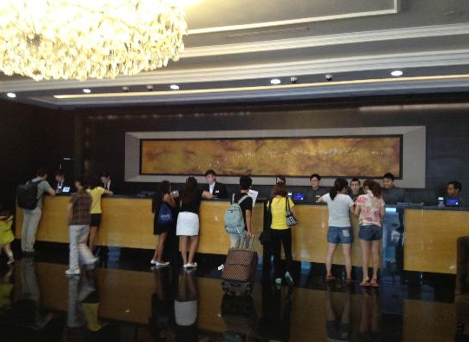
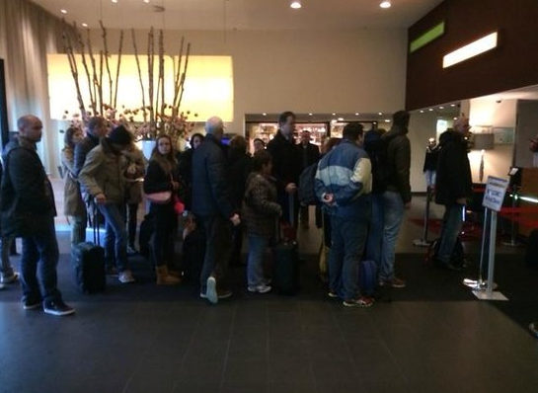
Introduction
Many BIG hotel + big amount of customer => difficult management
Customer have to come to hotel for booking => not convenient
=> Need software + website for hotel booking.

Slide 4
Introduction
Many BIG hotel + big amount of customer => difficult management
Customer have to come to hotel for booking => not convenient
=> Need software + website for hotel booking.
Weakness:
+ always load page, run very slow => customers don’t feel comfortable
+ administrators may not know customer’s behavior on software or website
My Hotel Booking & Reservation System
+ Single page application => high performance => more comfortable
+ Fully features support for Hotel Booking & Reservation
+ Track customer’s behavior => follow customers => improve hotel business.

Slide 5
Use Case

Slide 6
Technology used
1. Server side: - Java web J2EE + Spring MVC framework
- Node.js + Express framework
2. Client side: - HTML5, CSS3, Javascript, Jquery, Boostrap
- Angular 2 framework
3. Database: MongoDB
4. Server: Glassfish, npm http server
5: Version control: Git
6: Project management tool: Trello
7: Other tool: Edraw, Netbeans, Vscode, RoboMongo

Slide 7
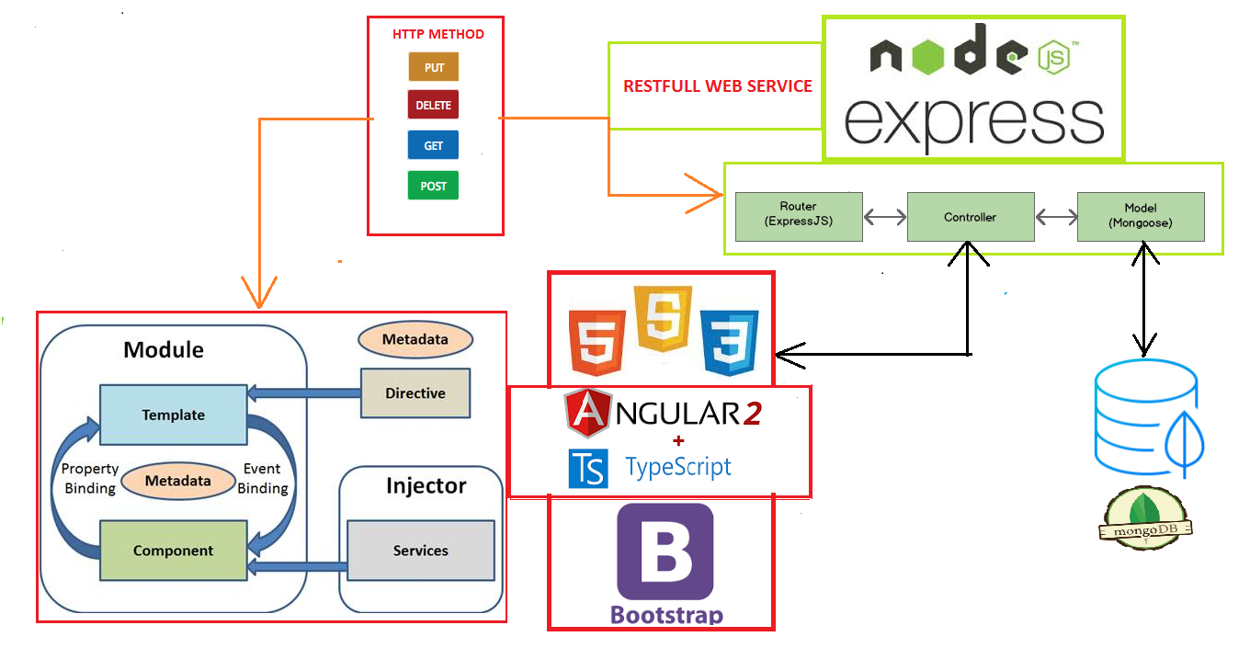
System Architecture

Slide 8
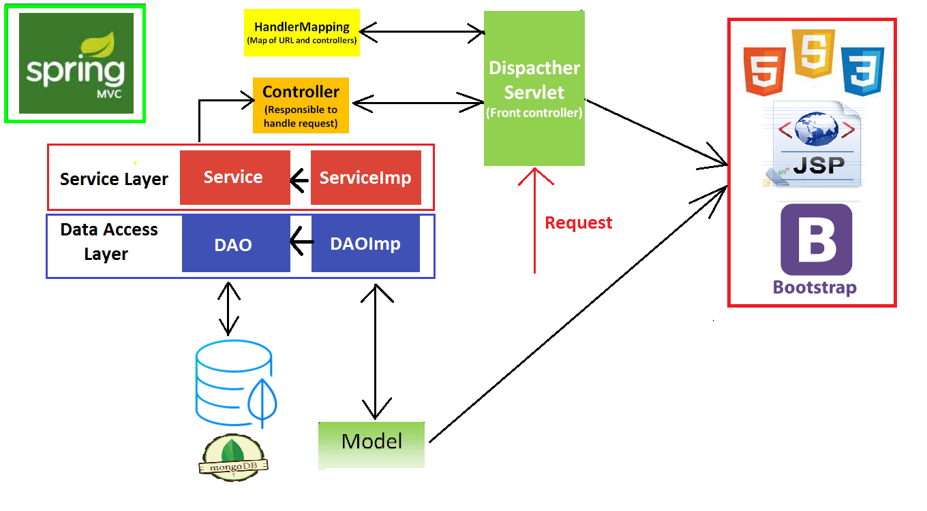
System Architecture

Slide 9
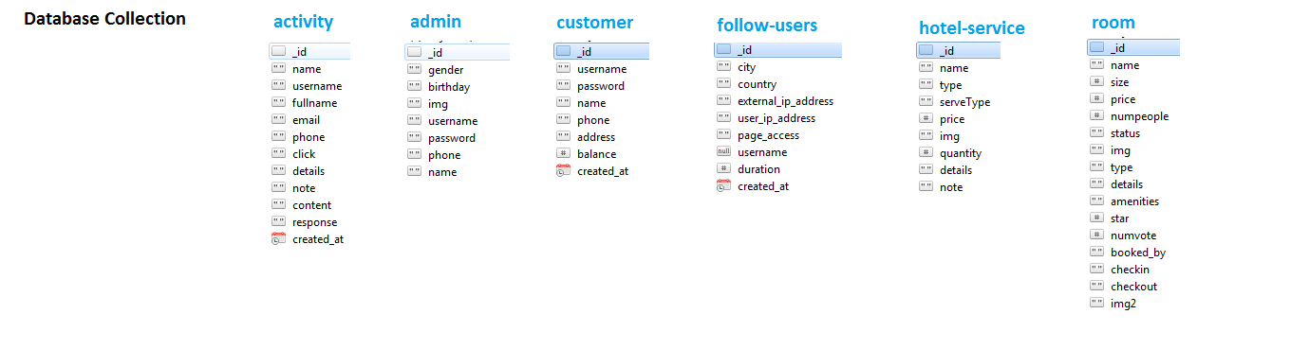
Database Structure

Slide 10
Demo

Slide 11

Thank you for your listening

